Slide 1
Accessibility & Tech
Notes:
Particularly, Tech for those with visual impairments

Slide 2
How many people face visual impairments?
Total (all ages): 7,358,400 (2.3%)
Total (16 to 75+): 6,906,500 (8.6%)
Women: 3,810,600 (9.0%)
Men: 3,095,900 (8.0%)
Age 18 to 64: 3,831,700 (1.9%)
Age 65 and older: 3,000,400 (6.7%)
https://nfb.org/blindness-statistics

Slide 3
What is blindness?
The statutory definition of “legally blind” is that central visual acuity must be 20/200 or less in the better eye with the best possible correction or that the visual field must be 20 degrees or less.

Slide 4
Screen Readers
JAWS (Freedom Scientific)
NVDA (NV Access)
ChromeVox

Slide 5


Screen Readers
JAWS (Freedom Scientific)
NVDA (NV Access)

Slide 6
Screen Readers (mobile)
VoiceOver (iOS)
Talk Back (Android)

Slide 7
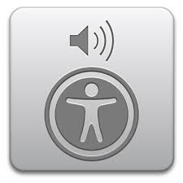
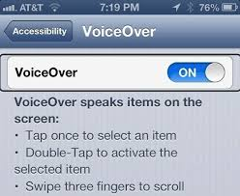
Screen Readers (mobile)
VoiceOver (iOS)
Notes:
Reads back mobile screen display.
Multi-gestural.

Slide 8
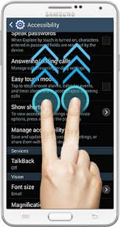
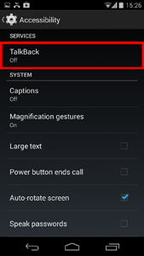
Screen Readers (mobile)
Google TalkBack
Notes:
High contrast highlighting.
Special Gestures

Slide 9

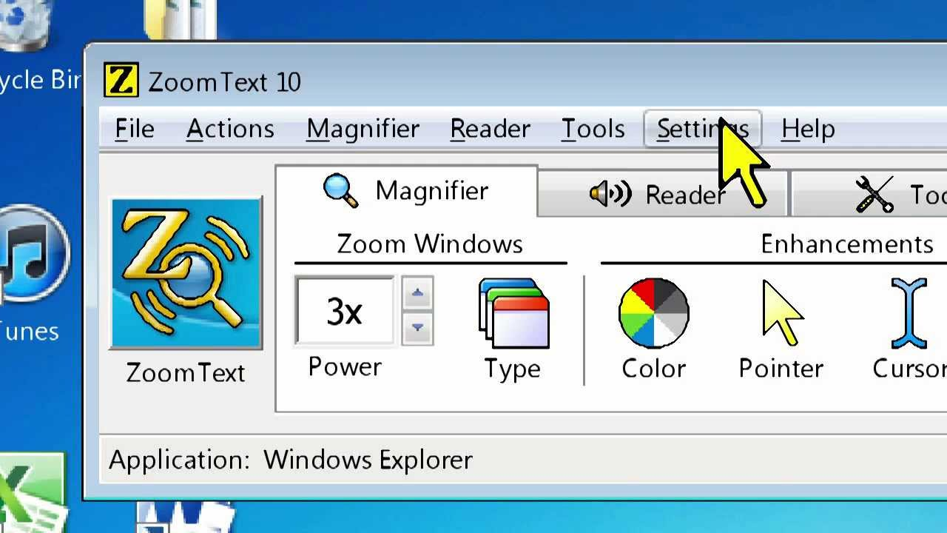
Magnifiers
ZoomText

Slide 10

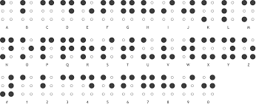
Braille

Slide 11
Refreshable Braille Displays

Slide 12
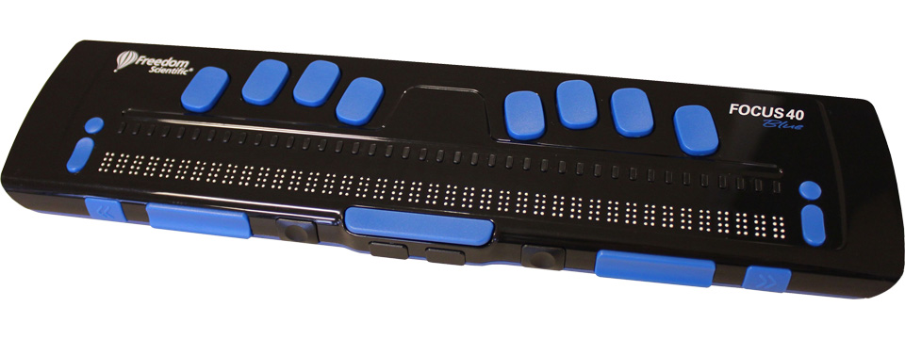
Braille Reader

Slide 13
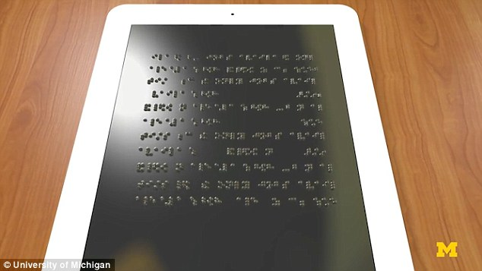
Braille Tablet
Notes:
Still being researched.
Will cost under $1000
Puff air to create dots thousands of dots with the ability to even represent pictures or graphs.
Still experimental, and won’t be ready for release until many years from now.

Slide 14
Accessible Rich Internet Applications (ARIA)
Aria Roles
Aria State Changes

Slide 15
ARIA Roles
<!-- This is a tabs widget. How would you know, looking only at the markup? -->
<ol>
<li id="ch1Tab">
<a href="#ch1Panel">Chapter 1</a>
</li>
<li id="ch2Tab">
<a href="#ch2Panel">Chapter 2</a>
</li>
<li id="quizTab">
<a href="#quizPanel">Quiz</a>
</li>
</ol>

Slide 16
ARIA Roles
<!-- We've added role attributes to describe the tab list and each tab. -->
<ol role="tablist">
<li id="ch1Tab" role="tab">
<a href="#ch1Panel">Chapter 1</a>
</li>
<li id="ch2Tab" role="tab">
<a href="#ch2Panel">Chapter 2</a>
</li>
<li id="quizTab" role="tab">
<a href="#quizPanel">Quiz</a>
</li>
</ol>

Slide 17
ARIA State Changes
ARIA provides attributes for declaring the current state of a UI widget. Examples include (but are certainly not limited to):
aria-checked: indicates the state of a checkbox or radio button
aria-disabled: indicates that an element is visible, but not editable or otherwise operable
aria-grabbed: indicates the 'grabbed' state of an object in a drag-and-drop operation

Slide 18
Using ARIA
Roles
Widget roles
Composite roles
Document structure roles
Landmark roles
States and properties
Widget attributes
Live region attributes
Drag & drop attributes
Relationship attributes
https://developer.mozilla.org/en-US/docs/Web/Accessibility/ARIA/ARIA_Techniques

Slide 19
Other Good Web Design Practices
Build a solid HTML page structure
Execute the fundamentals well

Slide 20
Other Good Web Design Practices
Enable keyboard navigation for web design
Obvious Keyboard Focus
All Interactive Elements Are Accessible
Consider a Skip Navigation Link

Slide 21
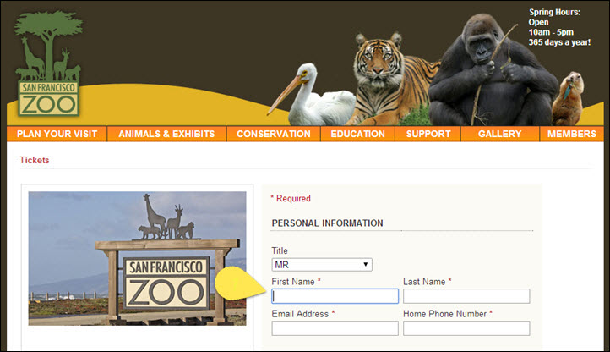
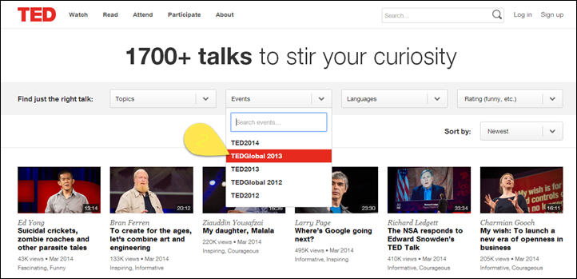
Enable keyboard navigation for web design

Slide 22
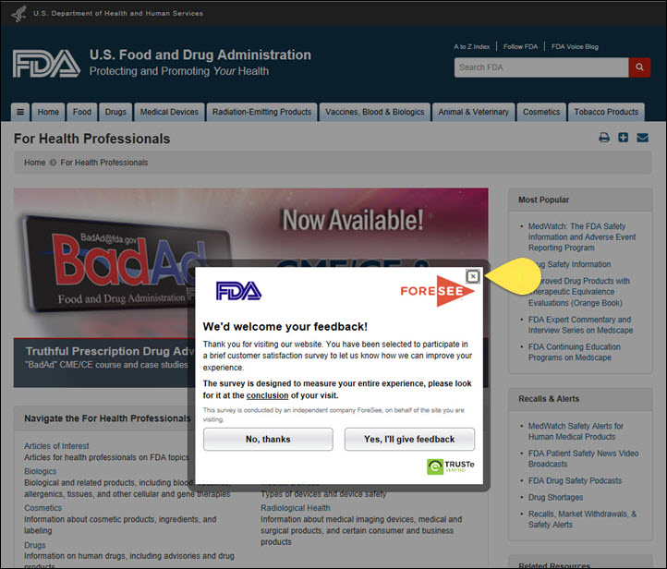
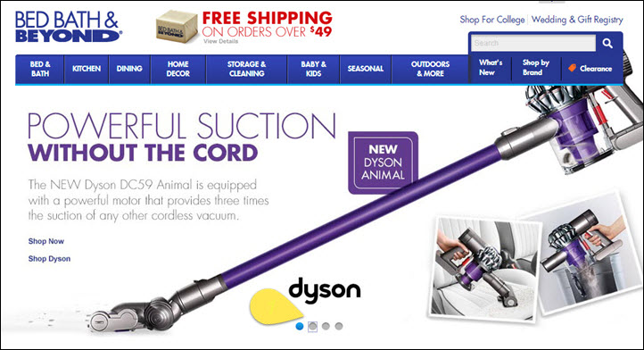
Enable keyboard navigation for web design

Slide 23
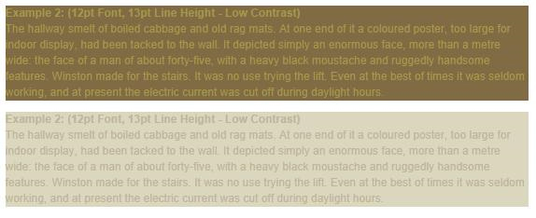
Prioritize Text Clarity

Slide 24
Accessible web design not only allows you to reach a larger audience, but it’s also the right thing to do.

